Slide 1
Formal Semantics for mixed language —work-in-progress

Slide 2
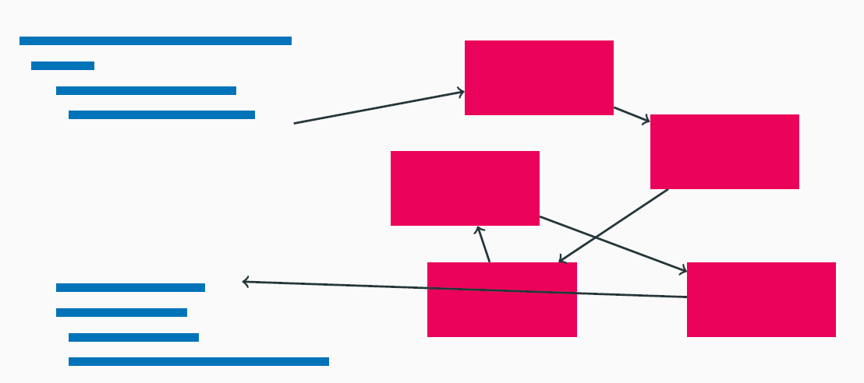
Hypervisor, OS kernels, etc. C program Inline Assembly

Slide 3
Questions we want to answer
How to verify a system with mixed language?

Slide 4
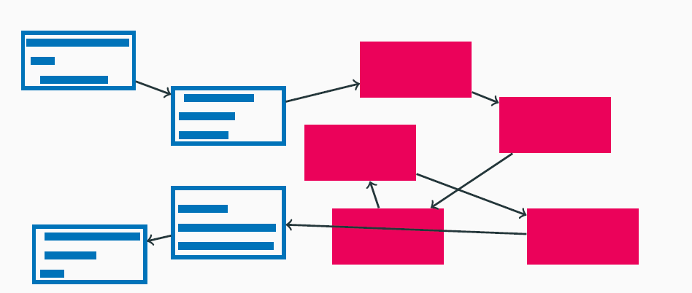
Prior approaches to verifying mixed-language programs
Option 1： Translate C codes into assembly
Con: discard the comfort that appropriate abstraction can provide

Slide 5
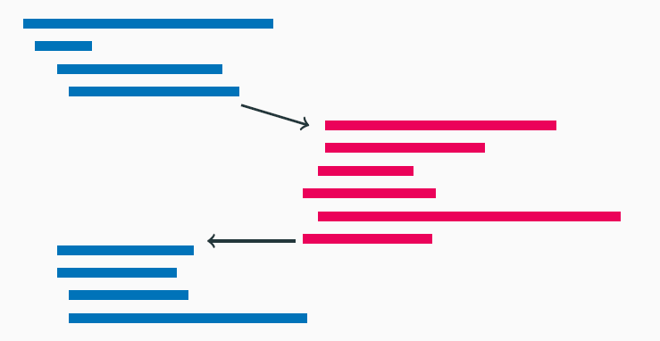
Prior approaches to verifying mixed-language programs
Option 2： Abstract assembler programs to a C models
Cons: comes with a lot of abstraction efforts

Slide 6
Our Goal
Allow verifying mixed-language programs that allows high-level code to remain high-level and low-level code to remain low-level.
We do this via mixing the semantics of C language and assembly language.
C calls Assembler Functions
Assembler calls C Functions
C Inline Assembly
Assembler accesses C variables

Slide 7
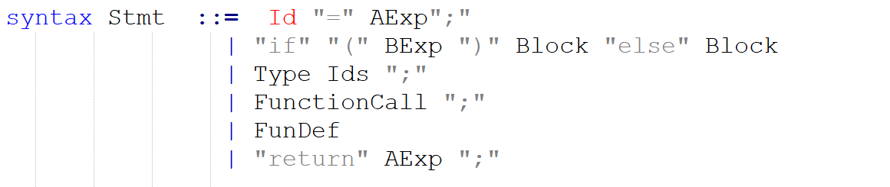
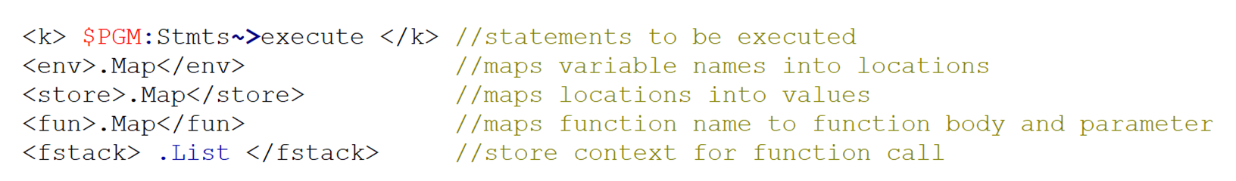
Syntax of C
configuration

Slide 8
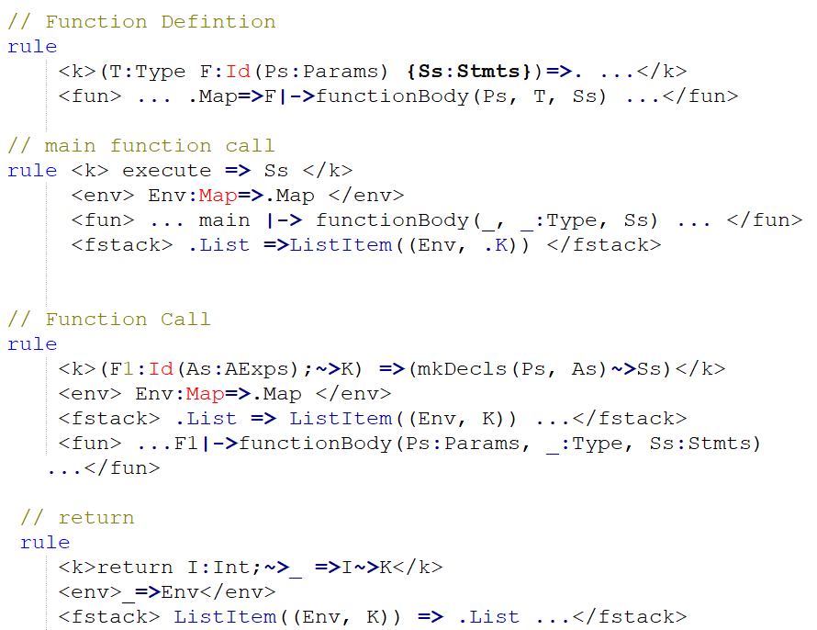
Semantics of C

Slide 9
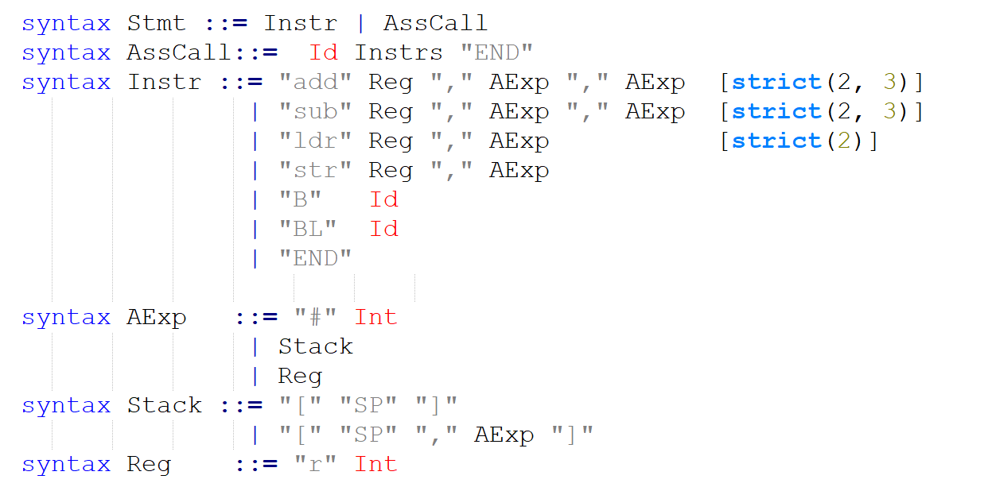
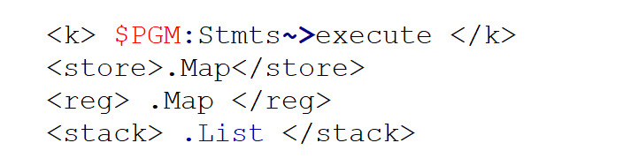
Syntax of Assembler
Configuration:

Slide 10
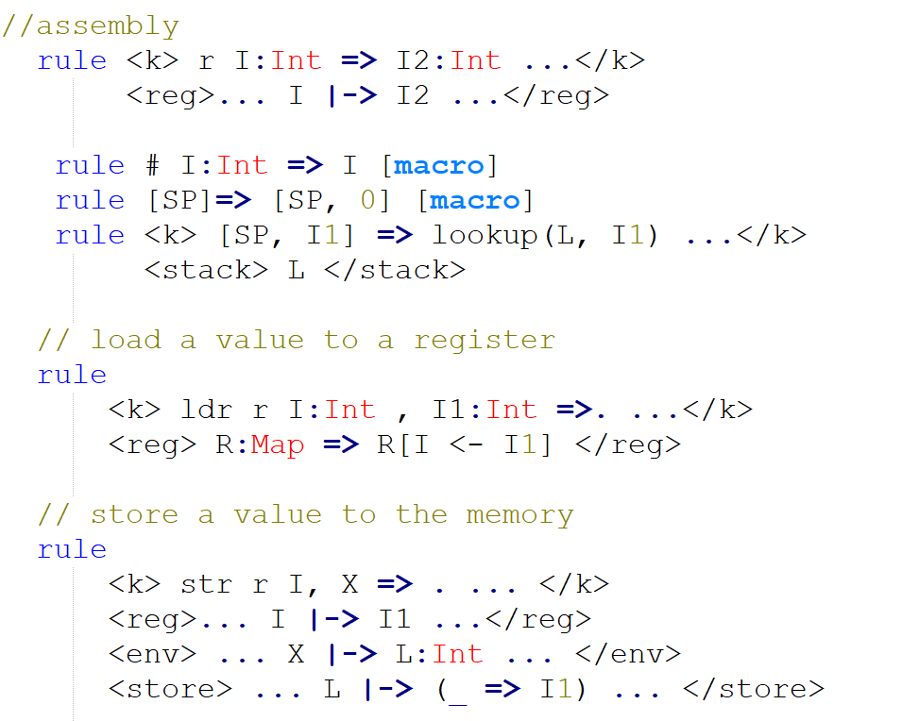
Semantics of Assembler

Slide 11
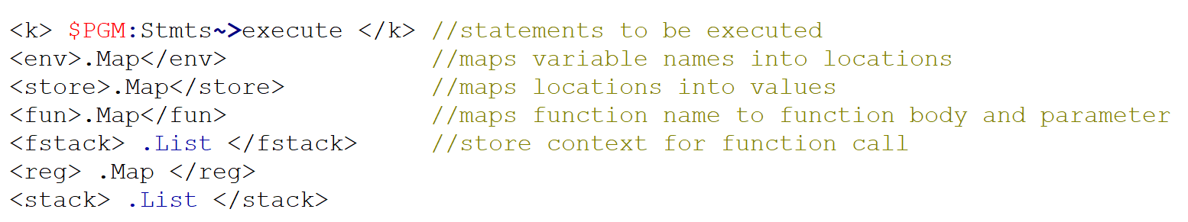
Integrated semantics
Configuration

Slide 12
Integrated semantics
C calls assembler functions
Assembly calls C functions
Inline Assembly

Slide 13
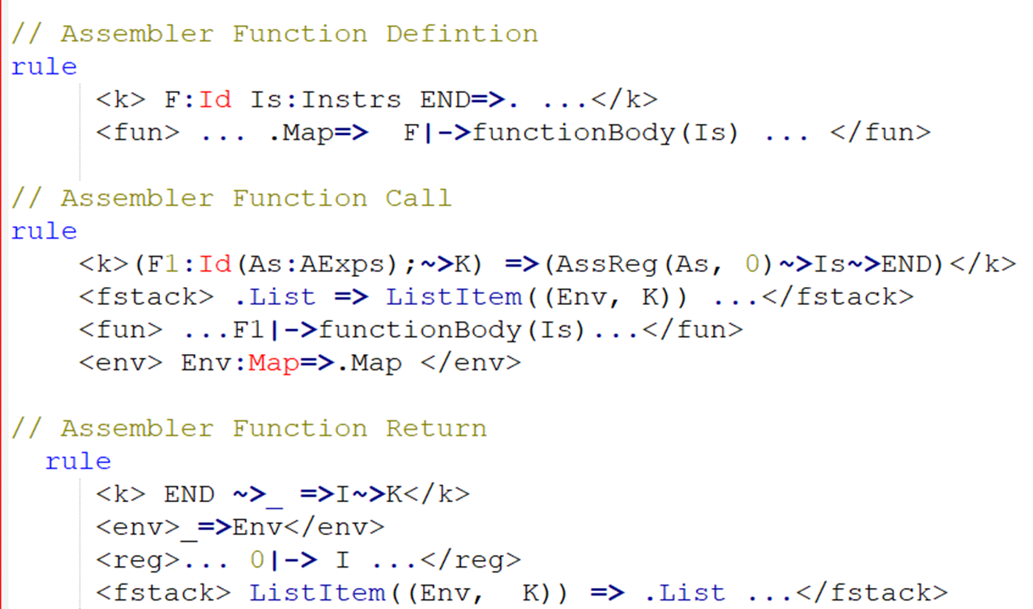
C calls assembler functions

Slide 14
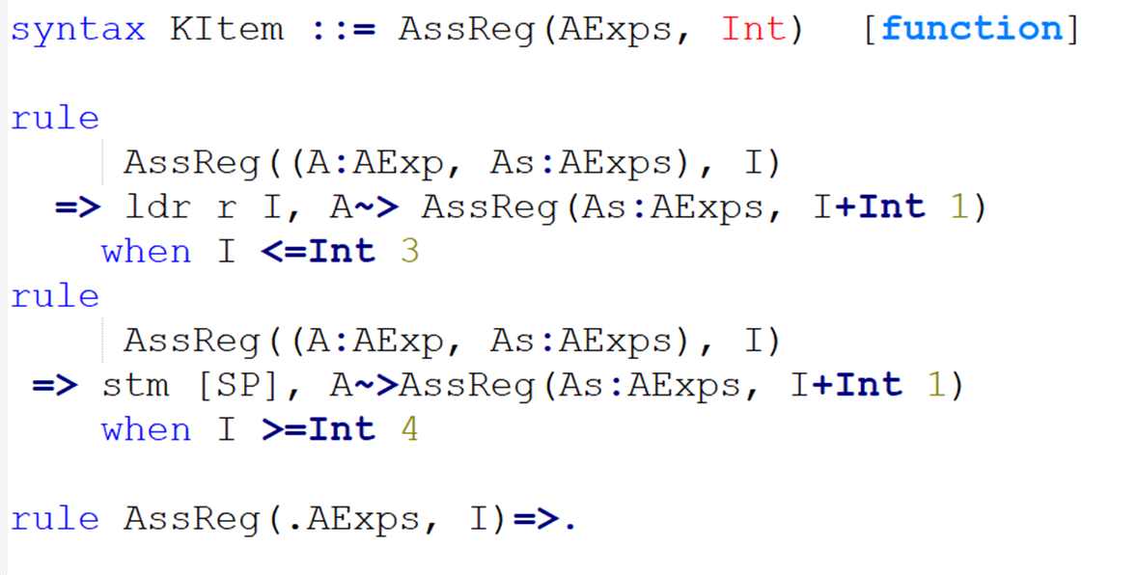
auxiliary function—AssReg()

Slide 15
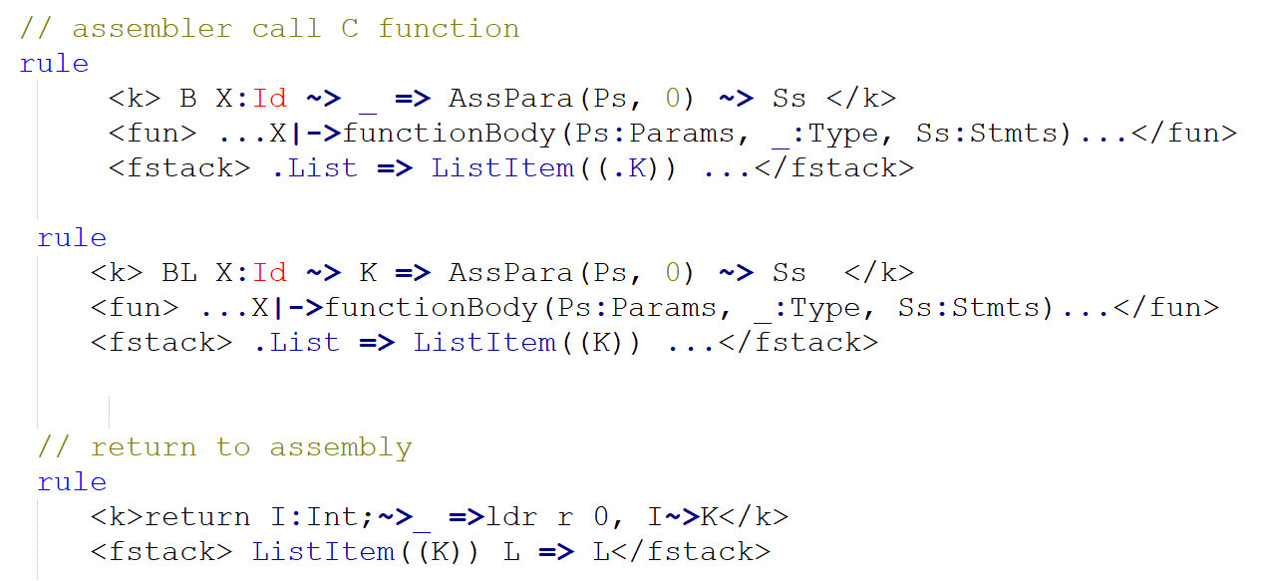
Assembly calls C functions

Slide 16
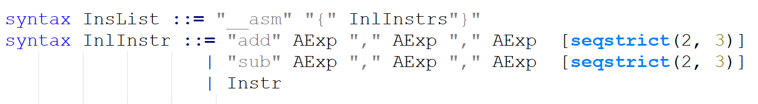
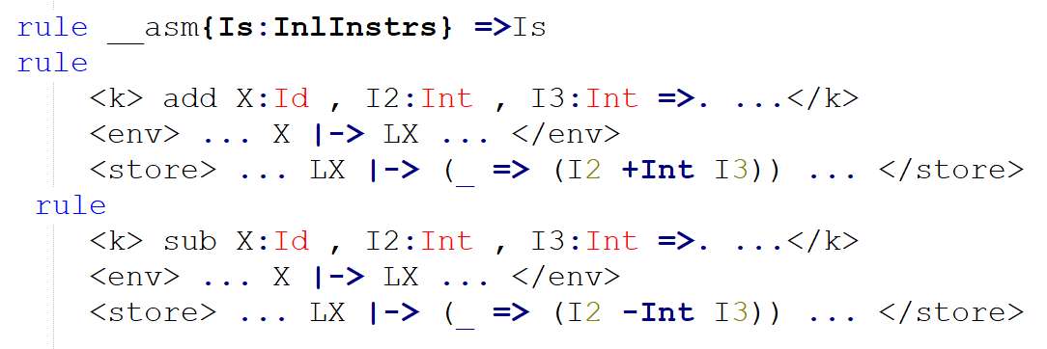
Inline Assembly

Slide 17
DEMO

Slide 18
Future Work
Complete the mixed language semantics
Pointer and list
Struct
Arrays
Assembler accesses C variables
Instructions
…
Verifying the Correctness of an OS kernel or Hypervisor

